Slide 1
C++ Programming: Problem Solving and Programming
Chapter 1
Introduction To Programming

Slide 2
Objectives
In this chapter you will:
Program and software
Learn about the language of a computer
Learn about the evolution of programming languages
Examine high-level programming languages
Discover what a compiler is and what it does
Examine how a high-level language program is processed
Compilation, executing and debugging
Good programming habits
2

Slide 3
Computer Components
Input
Hardware
Output
Process
Notes:
Hardware is the equipment associated with a computer. E.g. mainframe, computer, laptop, hand phone.
Input includes keyboard, mouse, touchpad, touch screen, keypad.
Output includes monitor, speakers, printers.
Process – it is instructions that control how and when data items are input, how the inputs are processed into information, and in what form the information are output or stored.

Slide 4
Computer Operations
Processing
Data
Keyboard data
Mouse click
Others
Information
Reports
Audio
Validation
Calculation
Storing
Others
Input
Output

Slide 5
Program and Software
Computer – programmable machine designed to follow instructions
Program – instructions in computer memory which computer follows to perform a task
Programmer – person who writes instructions (programs) to make computer perform a task
So, without programmers, no programs; without programs, a computer cannot do anything
5

Slide 6
Program and Software
Software is a collection of programs and data that instruct the computer what to do
Categories of software:
System software: Operating System that manage the computer hardware and the programs that run on them. Examples: Windows, UNIX, Linux
Application software: programs that provide services to the user. Examples : word processing, games, programs to solve specific problems
6

Slide 7
Program and Software
The programmer uses Computer / Programming Language to write programs
Syntax refers to the spelling and grammars of a programming language
Algorithm is a sequence of instructions written for computer to solve a problem.
7
Notes:
7

Slide 8
Algorithms (Example)
Steps for a customer to buy a movie ticket
Queue up
Go to the designated counter
Order ticket
Specify movie
Specify time
Specify number of tickets
Make payment
Get tickets
Leave the counter

Slide 9
Computer Languages
Categories of computer languages:
Machine language
Symbolic/Assembly language
High-level language
9
Notes:
9

Slide 10
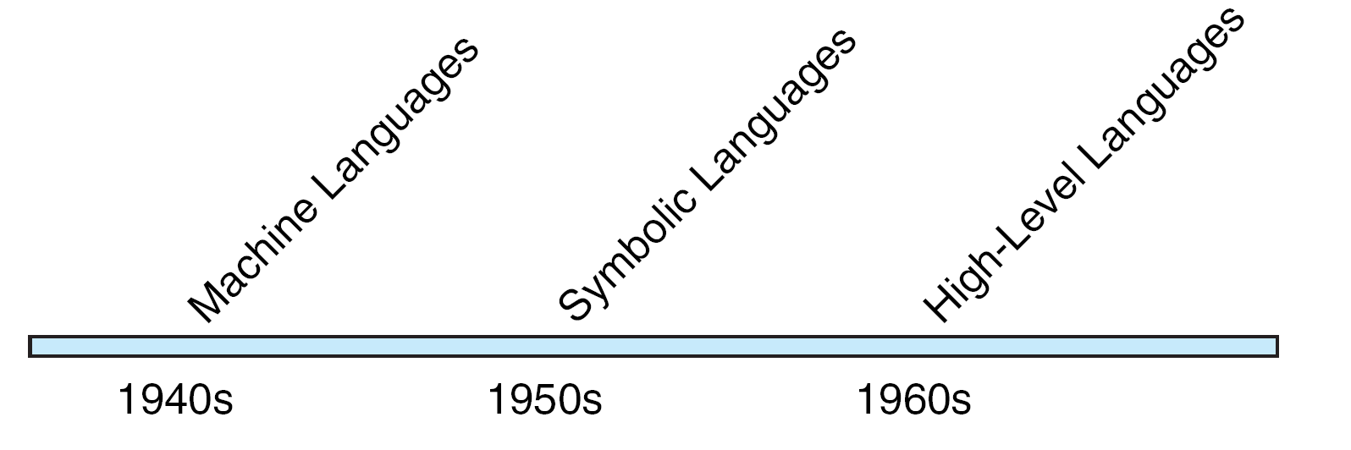
Evolution of Computer Languages
10

Slide 11
Machine Language
The computer can only understand and execute machine language instructions
Machine language instructions consist of binary numbers (0s and 1s) such as 10110100000101
It is platform-dependent
Rather than writing programs in machine language which is very hard, the programmers use other programming languages
11

Slide 12
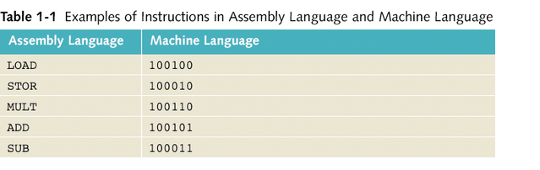
Symbolic/Assembly Language
Use symbolic codes, mnemonic and meaning abbreviations. It is also platform-dependent
Assembler: used to translate a program written in assembly language into machine language for execution by the computer
Easier to program
12

Slide 13
High-Level Language
Use English-like codes and mathematical operators
It is platform-independent
High-level languages include Python, C++, C, C#, Java, Swift, etc
Compiler: used to translate a program written in a high-level language to machine language
Very easy to program
13

Slide 14
Creating a Simple Program
Program coding
Text editor (such as Notepad)
Integrated Development Environment (IDE)
Type of application
Console (command line)
Windows (desktop)
Web
Notes:
An IDE is a software package that provides an editor, compiler, and other programming tools. We are going to use Microsoft Visual Studio (with C++ environment).

Slide 15
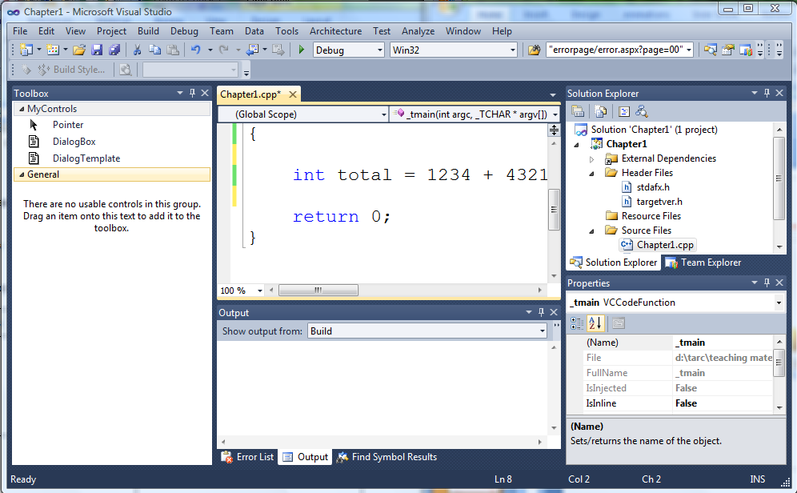
Example of IDE - Visual Studio
Build: To compile code
Build
Run: To execute program
Text editor: write code
Output: Check error/ status

Slide 16
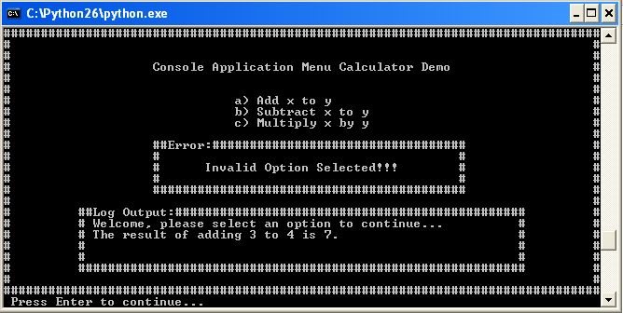
Console Application

Slide 17
Compilation process of C++ program
1) Source code is written in C++
Editor
Library
2) Convert the C++ code into object code
Compiler
disk
3) Linker links the object code with libraries
Linker
4) Loader puts program in memory
Loader
Memory
5) Ready to run (platform-dependent)
CPU

Slide 18
Program Development
To develop a program, programmer must complete the following steps:
Understand the problem
Develop a solution
Write the program
Test the program
18
Notes:
18

Slide 19
Program Development
Understand the problem
Understand the problem
Carefully study the user requirements.
Understand what he wants the program to do and what kind of output he wants to have.
Develop a solution
Write the program
Test the program
19
Notes:
19

Slide 20
Program Development
Understand the problem
Develop a solution
Design the logic of the program by using tools such as:
Structure chart
Pseudocode
Flowchart
Develop a solution
Write the program
Test the program
20

Slide 21
Program Development
Understand the problem
Write the program
Code the actual program by using the preferred programming language.
Develop a solution
Write the program
Test the program
21
Notes:
21

Slide 22
Program Development
Understand the problem
Test the program
Run and test the program to ensure it is free of logical errors.
Develop a solution
Write the program
Test the program
22

Slide 23
Example 1-1 : Rectangle
Write a C++ program to find the area and perimeter of a rectangle
The area and perimeter of the rectangle are given by the following formulas:
perimeter = 2 * (length + width)
area = length * width
23
Notes:
23

Slide 24
Tool: Structure Chart
A hierarchy chart that shows the functional flow through the program.
Shows how the program is broken into logical steps. Each step will be a separate module.
24
Notes:
24

Slide 25
Example 1.1: Structure chart
Area & perimeter of rectangular
Get length & width
Calculate area & perimeter
Display area & perimeter
Notes:
25

Slide 26
Tool: Pseudocode (Algorithm)
Use English words to convey program logic.
Contains the logical steps / algorithms to accomplish the task.
26
Notes:
26

Slide 27
Example 1-1 : Pseudocode
Start
1. Get length of the rectangle
2. Get width of the rectangle
3. perimeter = 2 * (length + width)
4. area = length * width
5. Display area and perimeter
End
27

Slide 28
Tool: Flowchart
Use standard graphical symbols to represent the logical flow of data through a program.
28

Slide 29
Flowchart Symbols
Input/Output
Processing
Module
Terminal
Decision
Flowlines
On-page Connector
Off-page Connector

Slide 30
Example 1.1: Flowchart
START
Read length & width
area =
Length * width
perimeter =
2 * (Length + width)
Display area & perimeter
END

Slide 31
Example 1-1 : C++ program
#include <iostream>
using namespace std;
main() {
int length, width, area, perimeter;
cout<<"Enter length and width of
rectangle\n";
cin>>length;
cin>>width;
area = length * width;
perimeter = 2*(length + width);
cout<< "Area = "<<area;
cout<< "Perimeter = "<<perimeter;
return 0;
}
31

Slide 32
Exercise
By using structure chart, pseudocode and flowchart, find the total and product of 2 numbers. Display the result.
32

Slide 33
Debugging
To find any error in the program
Bugs – error, also known as exception, occurs during compilation or execution.
Common programming errors:
Syntax errors (Compilation errors)
Run-time errors
Logic errors

Slide 34
Common programming errors
Syntax Errors
Code violation during compilation, e.g.:
Missing semicolon (;)
Undefined variable
Did not close ’/*’ with ‘/’
Run-time Errors
Illegal operation occur during execution , e.g.:
Divide a number by zero
Open a non-existing file
Write to a non-existing printer
Notes:
Error occurs during compilation time is known as compilation error. Usually caused by syntax error.
Error occurs during execution time is known as runtime error. It can be fatal which is caused by system error. Nonfatal error is usually caused by program logic error.

Slide 35
Common programming errors
Logic Errors
Passed Syntax and Run-time Errors but produce false result
It is usually caused by the algorithm of the program
// to calculate the average
int a =20;
int b = 34;
cout << “The average is ” << (a + b); ← Used wrong formula

Slide 36
C++ Basic Syntax
#include <iostream> //allow input/output
int main() //starting point
{
int mark; // variable declaration
std::cout << “Sample: \n Enter mark:”; //display
std::cin >> mark; //get input
std::cout << “Mark is ” << Mark << std::endl;
return 0; //end point
}
preprocessor directive
variable
Escape sequence
Data type
comment
Use semicolon (;) to end a statement
Notes:
Line 1: #include <iostream> is a preprocessor directive, a message to the C++ preprocessor and to be processed before the code is compiled.
Line 2: int main() is a command indicating the program execution begins after this line.
Line 3 and Line 9: { } to include a set of instructions within this scope (function).
Line 4: to declare the variable named Mark, which is an integer. You are going to learn this in the next part of this chapter.
Line 5: std::cout standard output stream object. << operator is referred as the stream insertion operator. It indicates that the value of the right operand (e.g. “Sample: \n Enter mark:”) is inserted in the output stream.
Line 5: \n is an escape sequence to insert a new line after writing “Sample:” on the screen, and “Enter mark:” begins next line.
Line 6: std::cin standard input stream object. >> operator is referred as the stream extraction operator. It indicates that the value obtained from the user is assigned to the variable (e.g. Mark). This statement directs the user to enter an integer.
Line 7: the fixed text (string) is combined with the variable (Mark) using << operator. std::endl ends the line.
Line 8: return 0 is used to exit a function. Value 0 indicates that the program has terminated successfully. This line can be omitted/ignored.
Remark: A statement (e.g. any line in between Line 4 to Line 8) must be terminated using a semicolon (;). A statement without that will be treated as syntax error.

Slide 37
Good Programming Habits
Use program comments
Use meaningful identifiers
Design clear statements
Write clear message & clear instruction
Backup your code
Notes:
Reference:
Farrell, J. 2011. A Beginner’s Guide to Programming Logic and Design. 6th edn. Course Technology. Pg. 68-77

